Slide 1


Reinforcement Learning
Haozhe Tian
haozhe.tian21@imperial.ac.uk
haozhetian.com

Slide 2
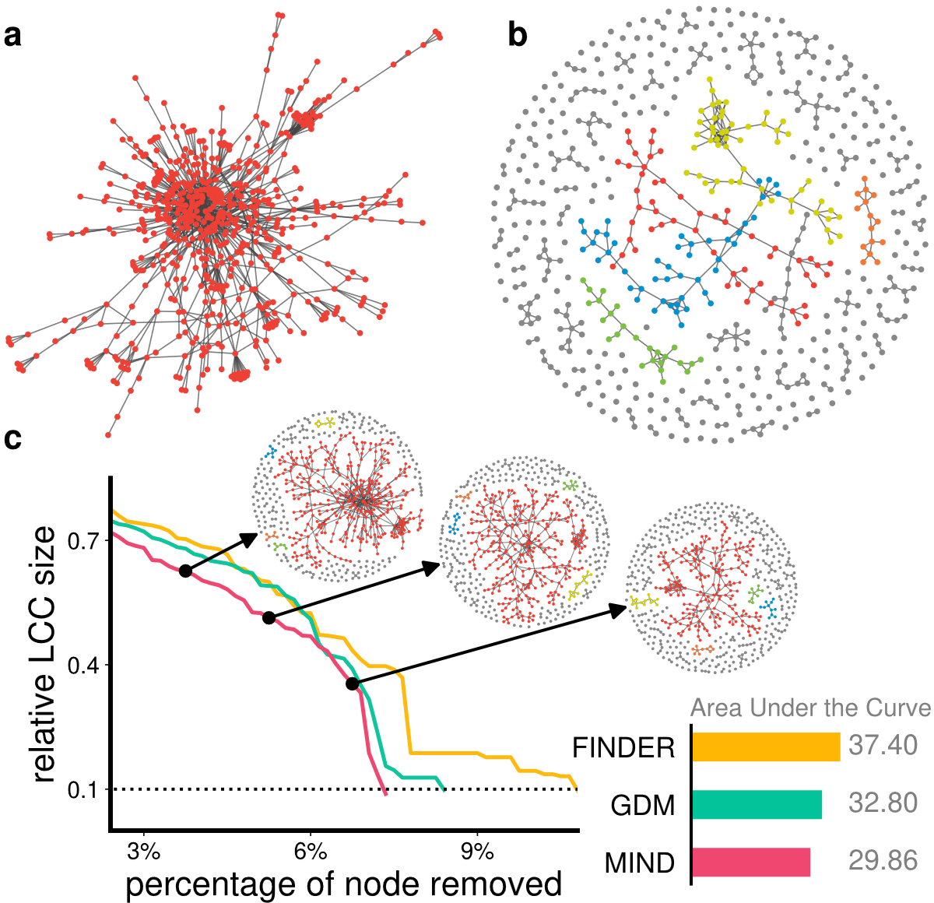
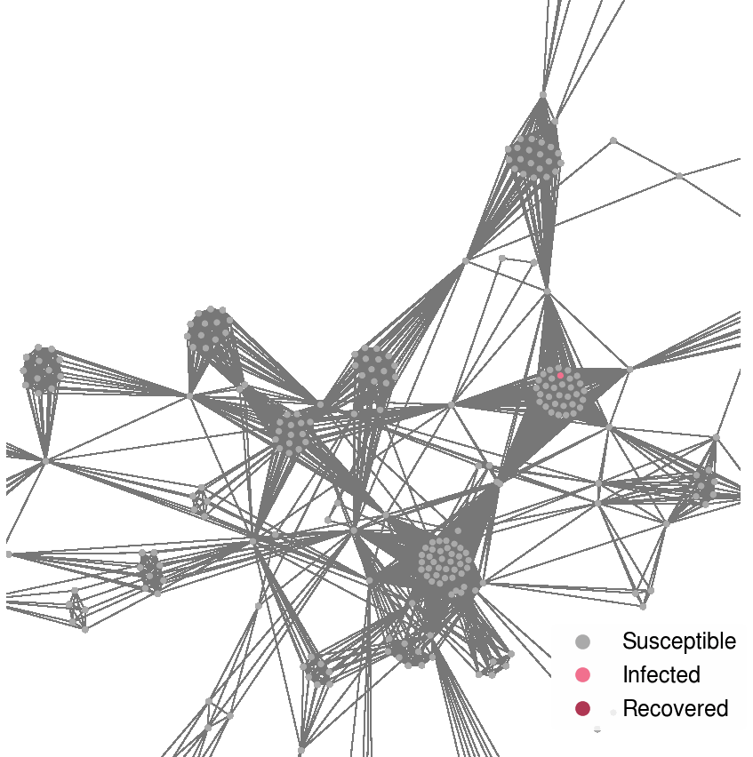
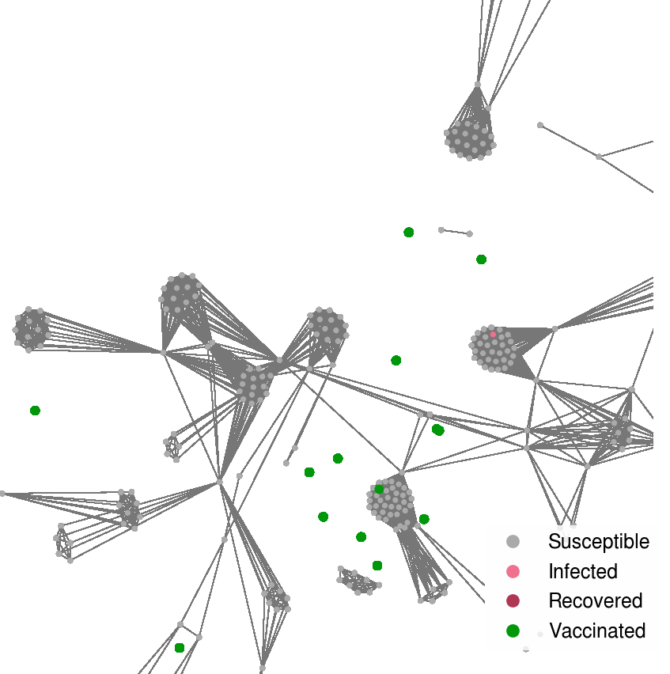
Myself
My work focuses on Reinforcement Learning, especially on safe reinforcement learning for safety-critical applications (e.g., controlling blood glucose levels).
I also work on complex networks, e.g., solving combinatorial network optimization problems using reinforcement learning.

Slide 3
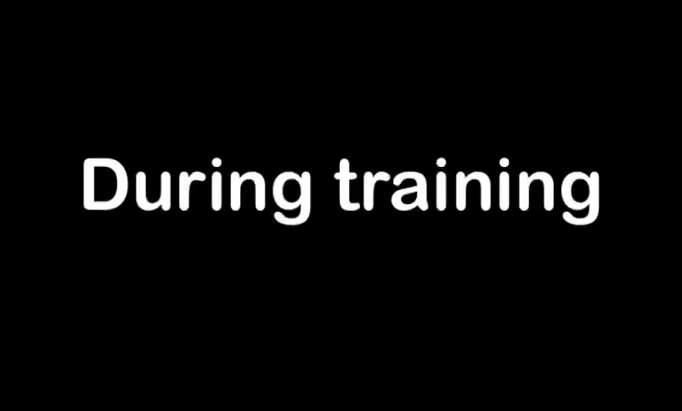
Introduction
  Personalized healthcare, automatic vehicles, large language models, etc. are all benefiting from an important framework in machine learning: Reinforcement Learning (RL).
Blood glucose level
Insulin dosage

Slide 4
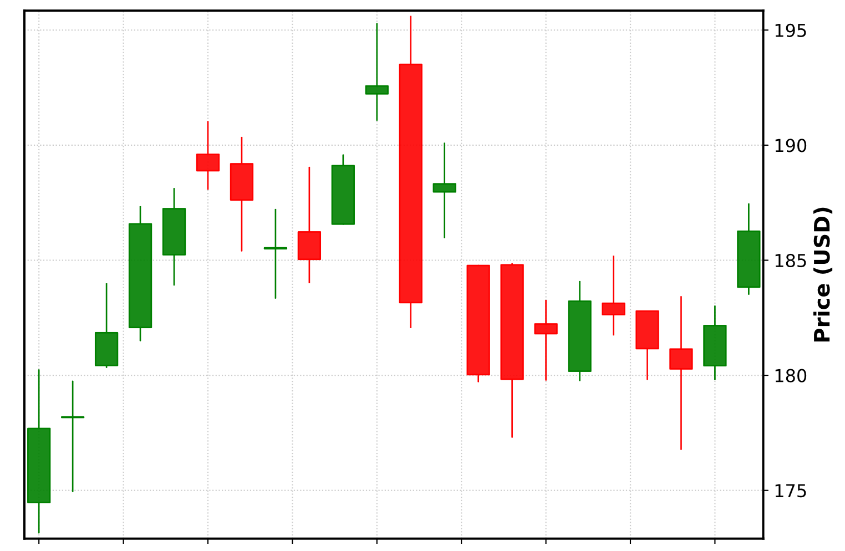









Introduction
Sell here?
Sequential decision-making problems (SDPs): decisions are made one after another, with each choice impacting future options and outcomes. One classic SDP is buying and selling stocks.
Buy
Sell here?
Sell here?
Two characteristics of SDP are:
  Sequential: each decision affecting future observations (chess vs. rock paper scissors)
  Non-greediness: balancing long-term reward and immediate reward
reward$=+3$
reward$=+3$
$$s_{1}$$
$$s_{2}$$
Greedy solution
$$s_{0}$$
reward$=0$
reward$=+7$
$$s_{3}$$
$$s_{4}$$
Optimal solution
Notes:
MDP have two characteristics,
one is that it is sequential, meaning we make a sequence of decisions, therefore rps is not an SDP, bandit is also not an SDP. This means we need to plan in the future, see stock example
SDP is also non-greedy, meaning that taking greedy step every step might not be the best thing to do

Slide 5
Introduction
Solving SDP requires long-term planning (predicting the future effect of each decision)
Reinforcement learning (RL) offers a data-driven solution for SDPs.
RL Training Paradigm
Agent
State/Observation
Reward
Action
Environment
Example
Agent
  You might also want to think about why this is non-greedy
Blood pressure, blood test results, heart rate, etc.
Recovery?
prescription
Patient
Notes:
Now that we know what SDP means, RL is a data-driven way to solve this problem.
These plots show how RL model the problem. The paradigm has two components: the agent and the environment
At each step, the agent sees an observation and make a decision on what action to take
Which is fed to the environment. The environment then provides a feedback on the effect and the next observation
One example here is the treatment of a patient

Slide 6
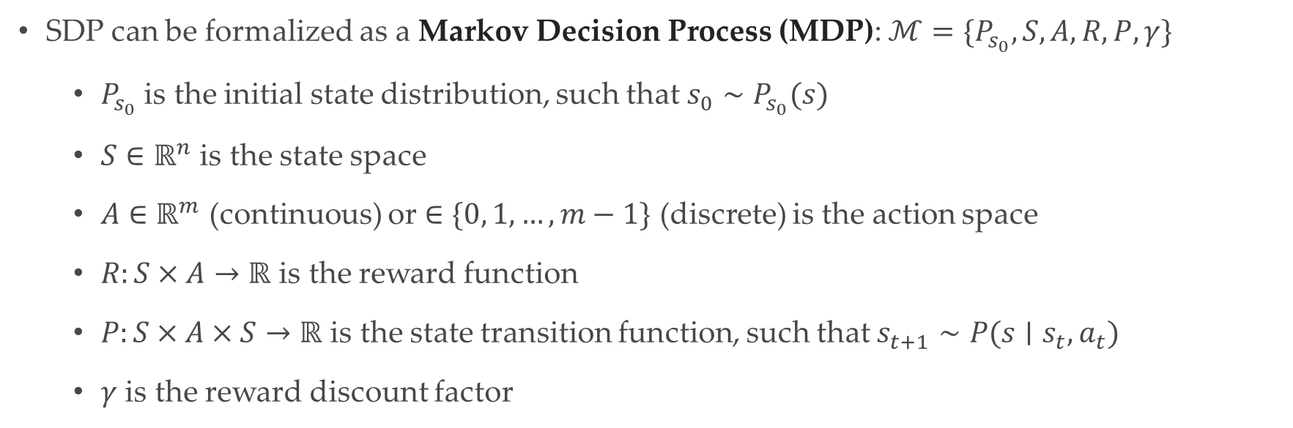
Preliminary
SDP can be formalized as a Markov Decision Process (MDP): $ℳ=\{P_{s_{0}}, S, A, R,P, γ\}$
  $P_{s_{0}}$ is the initial state distribution, such that $s_{0}∼P_{s_{0}}(s)$
  $S∈ℝ^{n}$ is the state space
  $A∈ℝ^{m}$ (continuous) or $∈\{0, 1, …,m−1\}$ (discrete) is the action space
  $R:S×A→ℝ$ is the reward function
  $P:S×A×S→ℝ$ is the state transition function, such that $s_{t+1}∼P(s∣s_{t}, a_{t})$
  $γ$ is the reward discount factor
Why called Markov?
  $s_{t+1}$ only effected by $s_{t}$ and $a_{t}$, i.e., $s_{t+1}∼P(s∣s_{t}, a_{t})$ instead of $s_{t+1}∼P(s∣s_{0},a_{0},…,s_{t}, a_{t})$
Notes:
Formally, people usually use mdp to model an sdp
Here are the notations we are going to use
Continuous action space: vaccine, rotation of steering wheel; discrete action space: buttons on an Atari gaming console

Slide 7
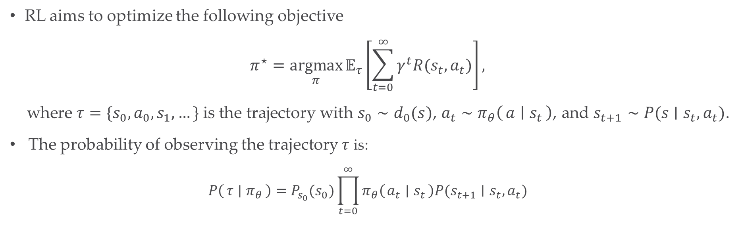
Preliminary
RL aims to optimize the following objective
$$π^{⋆}=\underset{π}{argmax}{𝔼_{τ}\left[\sum_{t=0}^{∞}{γ^{t}R(s_{t},a_{t})}\right]},$$
where $τ=\{s_{0}, a_{0}, s_{1}, …\}$ is the trajectory with $s_{0}∼d_{0}(s)$, $a_{t}∼π_{θ}\left(a ∣ s_{t}\right)$, and $s_{t+1}∼P(s∣s_{t}, a_{t})$.
The probability of observing the trajectory $τ$ is:
$$P\left(τ ∣ π_{θ}\right)=P_{s_{0}}(s_{0})\prod_{t=0}^{∞}{π_{θ}\left(a_{t} ∣ s_{t}\right)P(s_{t+1}∣s_{t},a_{t})}$$

Slide 8
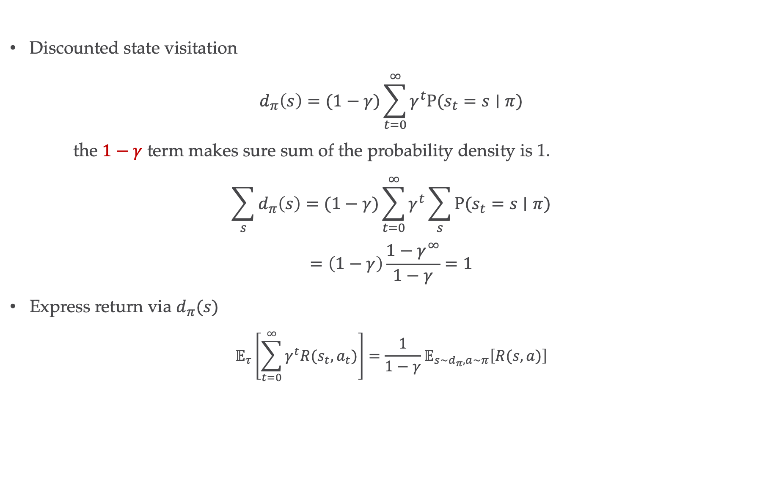
Preliminary
Discounted state visitation
$$d_{π}\left(s\right)=(1−γ)\sum_{t=0}^{∞}{γ^{t}P(s_{t}=s∣π)}$$
the $1−γ$ term makes sure sum of the probability density is 1.
$$\sum_{s}{d_{π}\left(s\right)=(1−γ)\sum_{t=0}^{∞}{γ^{t}\sum_{s}{P(s_{t}=s∣π})}}$$
$$=\left(1−γ\right)\frac{1−γ^{∞}}{1−γ}=1$$
Express return via $d_{π}(s)$
$$𝔼_{τ}\left[\sum_{t=0}^{∞}{γ^{t}R(s_{t},a_{t})}\right]=\frac{1}{1−γ}𝔼_{s∼d_{π}, a∼π}\left[R(s, a)\right]$$
Equals 1

Slide 9
Solutions
Policy Gradient
Actor Critic
On-policy
Off-policy
A method is on-policy when the policy used to collect data is the same as the policy being learned, and off-policy when the policy used to collect data is from the policy being learned.
Notes:
Badminton example,
though it sounds silly, but they are very important design choices in real life applications

Slide 10
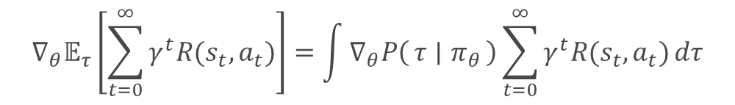
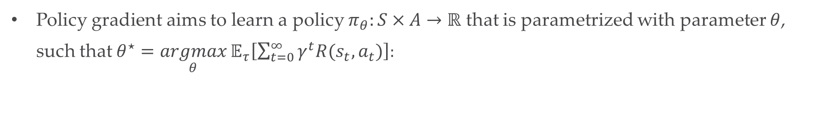
Solution: Policy Gradient
Policy gradient aims to learn a policy $π_{θ}:S×A→ℝ$ that is parametrized with parameter $θ$, such that $θ^{⋆}=\underset{θ}{argmax}{𝔼_{τ}\left[\sum_{t=0}^{∞}{γ^{t}R(s_{t},a_{t})}\right]}$:
$$∇_{θ}𝔼_{τ}\left[\sum_{t=0}^{∞}{γ^{t}R(s_{t},a_{t})}\right]=\int{∇_{θ}P\left(τ ∣ π_{θ}\right)\sum_{t=0}^{∞}{γ^{t}R(s_{t},a_{t})}dτ}$$
  Derivation:

Slide 11
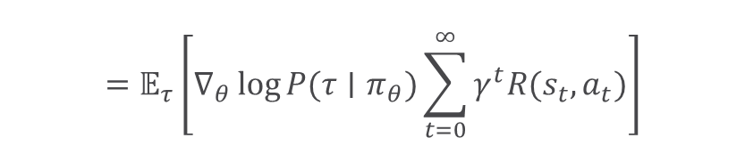
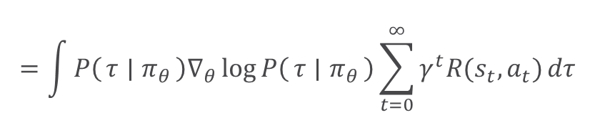

Solution: Policy Gradient
Policy gradient aims to learn a policy $π_{θ}:S×A→ℝ$ that is parametrized with parameter $θ$, such that $θ^{⋆}=\underset{θ}{argmax}{𝔼_{τ}\left[\sum_{t=0}^{∞}{γ^{t}R(s_{t},a_{t})}\right]}$:
$$∇_{θ}𝔼_{τ}\left[\sum_{t=0}^{∞}{γ^{t}R(s_{t},a_{t})}\right]=\int{∇_{θ}P\left(τ ∣ π_{θ}\right)\sum_{t=0}^{∞}{γ^{t}R(s_{t},a_{t})}dτ}$$
$$=\int{P\left(τ ∣ π_{θ}\right)∇_{θ}\log{P\left(τ ∣ π_{θ}\right)}\sum_{t=0}^{∞}{γ^{t}R(s_{t},a_{t})}dτ}$$
$$∇f\left(x\right)=f\left(x\right)∇\log{f(x)}$$
$$=𝔼_{τ}\left[∇_{θ}\log{P(τ∣π_{θ})}\sum_{t=0}^{∞}{γ^{t}R(s_{t},a_{t})}\right]$$
By using this trick, we transform:
gradient of expectation
expectation of gradient

Slide 12
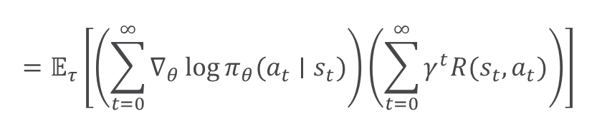
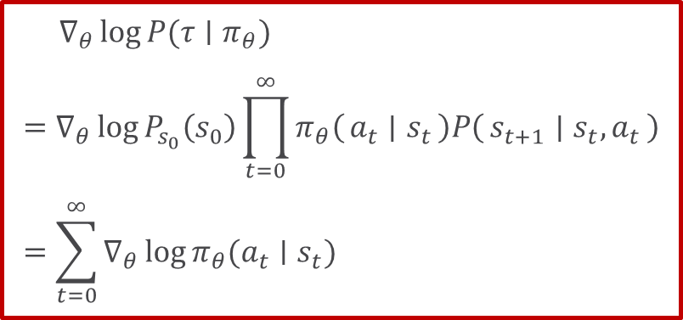
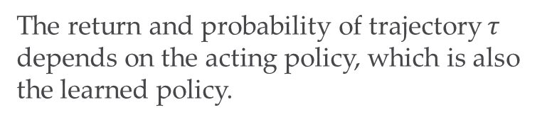
Solution: Policy Gradient
Policy gradient aims to learn a policy $π_{θ}:S×A→ℝ$ that is parametrized with parameter $θ$, such that $θ^{⋆}=\underset{θ}{argmax}{𝔼_{τ}\left[\sum_{t=0}^{∞}{γ^{t}R(s_{t},a_{t})}\right]}$:
$$∇_{θ}𝔼_{τ}\left[\sum_{t=0}^{∞}{γ^{t}R(s_{t},a_{t})}\right]=\int{∇_{θ}P\left(τ ∣ π_{θ}\right)\sum_{t=0}^{∞}{γ^{t}R(s_{t},a_{t})}dτ}$$
$$=\int{P\left(τ ∣ π_{θ}\right)∇_{θ}\log{P\left(τ ∣ π_{θ}\right)}\sum_{t=0}^{∞}{γ^{t}R(s_{t},a_{t})}dτ}$$
$$=𝔼_{τ}\left[∇_{θ}\log{P(τ∣π_{θ})}\sum_{t=0}^{∞}{γ^{t}R(s_{t},a_{t})}\right]$$
$$∇_{θ}\log{P(τ∣π_{θ})}=∇_{θ}\log{P_{s_{0}}\left(s_{0}\right)\prod_{t=0}^{∞}{π_{θ}\left(a_{t} ∣ s_{t}\right)P\left(s_{t+1} ∣ s_{t},a_{t}\right)}}=\sum_{t=0}^{∞}{∇_{θ}\log{π_{θ}(a_{t}∣s_{t})}}$$
$$=𝔼_{τ}\left[\left(\sum_{t=0}^{∞}{∇_{θ}\log{π_{θ}(a_{t}∣s_{t})}}\right)\left(\sum_{t=0}^{∞}{γ^{t}R(s_{t},a_{t})}\right)\right]$$
The return and probability of trajectory $τ$ depends on the acting policy, which is also the learned policy.
On-policy

Slide 13

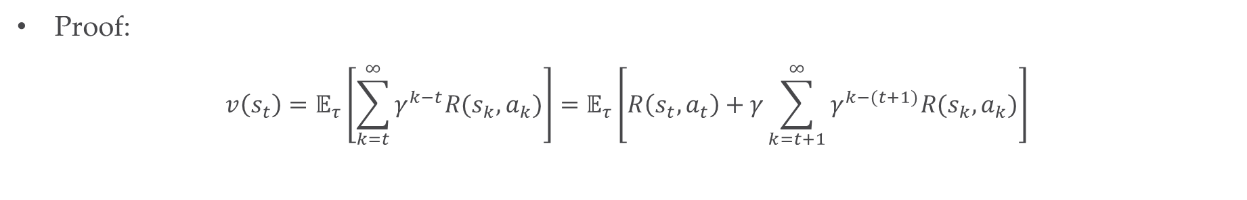
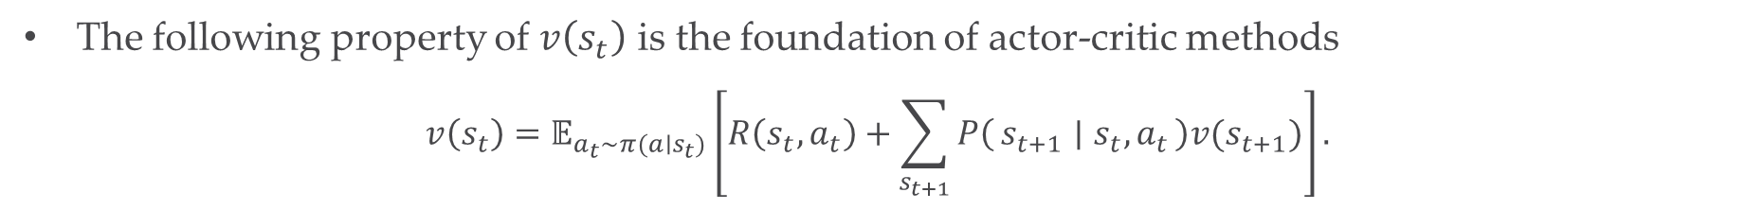
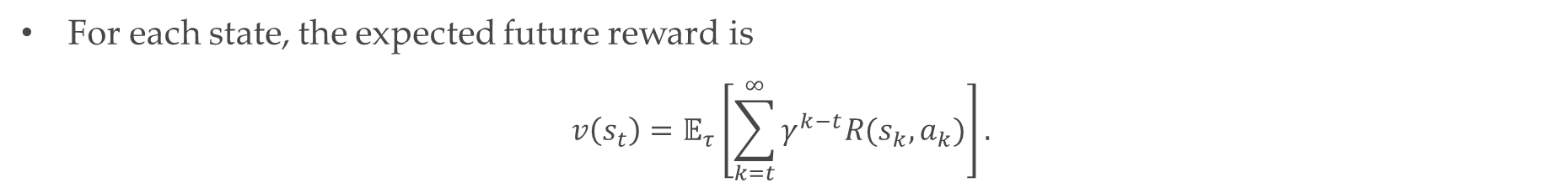
Solution: Actor-Critic
For each state, the expected future reward is
$$v\left(s_{t}\right)=𝔼_{τ}\left[\sum_{k=t}^{∞}{γ^{k−t}R(s_{k}, a_{k})}\right].$$
This is called the value function
The following property of $v\left(s_{t}\right)$ is the foundation of actor-critic methods
$$v\left(s_{t}\right)=𝔼_{a_{t}∼π(a∣s_{t})}\left[R\left(s_{t},a_{t}\right)+\sum_{s_{t+1}}{P\left(s_{t+1} ∣ s_{t}, a_{t}\right)v(s_{t+1})}\right].$$
(Bellman Equation)
Proof:
$$v\left(s_{t}\right)=𝔼_{τ}\left[\sum_{k=t}^{∞}{γ^{k−t}R(s_{k}, a_{k})}\right]=𝔼_{τ}\left[R\left(s_{t},a_{t}\right)+γ\sum_{k=t+1}^{∞}{γ^{k−(t+1)}R(s_{k}, a_{k})}\right]$$
$$v(s_{t+1})$$
Notes:
Before going into details of AC, we first introduce the value function

Slide 14
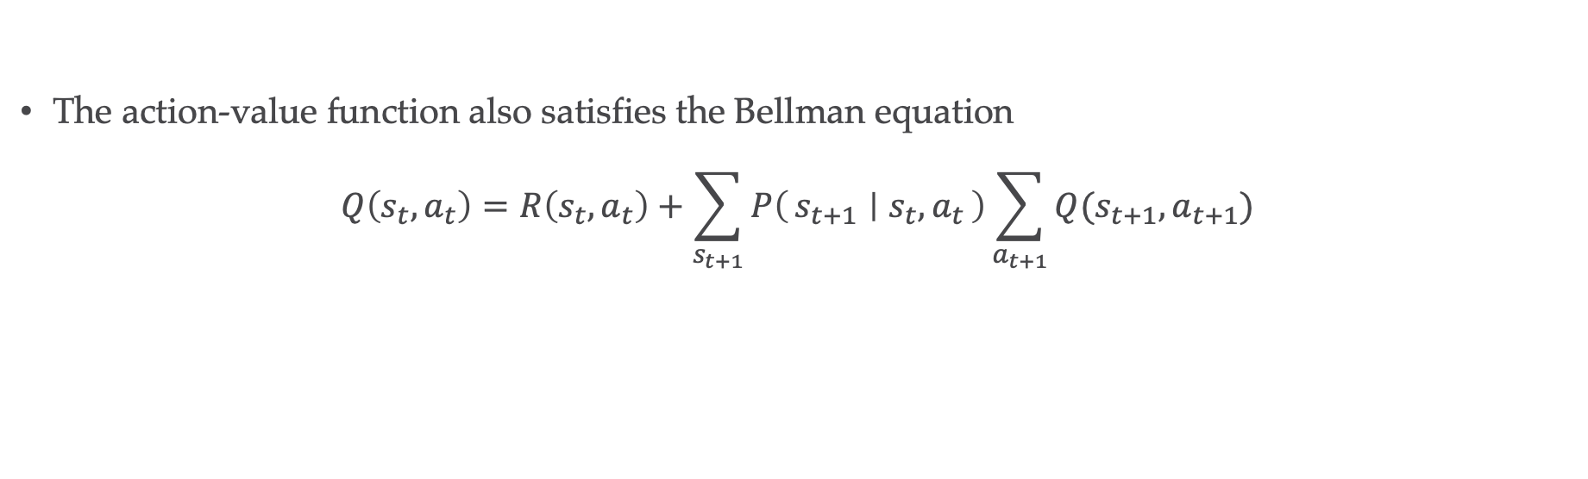
Solution: Actor-Critic
For each state, the expected future reward if action $a_{t}$ is taken is
$$Q\left(s_{t}, a_{t}\right)={R\left(s_{t}, a_{t}\right)+γ𝔼}_{s_{t+1}∼P(s∣s_{t}, a_{t})}\left[v(s_{t})\right].$$
(Action-value function)
The action-value function also satisfies the Bellman equation
$$Q\left(s_{t},a_{t}\right)=R\left(s_{t},a_{t}\right)+\sum_{s_{t+1}}{P\left(s_{t+1} ∣ s_{t}, a_{t}\right)\sum_{a_{t+1}}{Q(s_{t+1},a_{t+1})}}$$
(Bellman Equation)

Slide 15


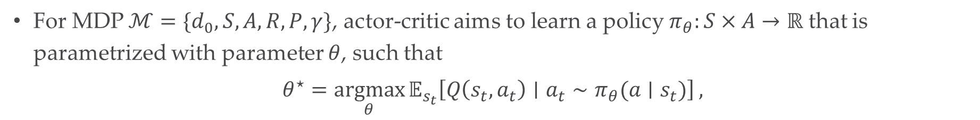
Solution: Actor-Critic
For MDP $ℳ=\{d_{0}, S, A, R,P, γ\}$, actor-critic aims to learn a policy $π_{θ}:S×A→ℝ$ that is parametrized with parameter $θ$, such that
$$θ^{⋆}=\underset{θ}{argmax}{𝔼_{s_{t}}\left[Q\left(s_{t}, a_{t}\right)∣a_{t}∼π_{θ}(a∣s_{t})\right]},$$
Bellman Estimation
Value Iteration
$$\min_{ψ}{𝔼_{{(s}_{t},a_{t},s_{t+1},a_{t+1})}\left[Q_{ψ}\left(s_{t}, a_{t}\right) −(R\left(s_{t},a_{t}\right)+γQ_{ψ}\left(s_{t+1},a_{t+1}\right))\right]}$$
Critic
Does not involve $π$
Off-policy
Policy Improvement
$$\max_{θ}{𝔼_{s_{t}}\left[Q\left(s_{t}, a_{t}\right)∣a_{t}∼π_{θ}(a∣s_{t})\right]}$$
Actor
Notes:
If time allows elaborate why this is a bellman estimation in the long run

Slide 16
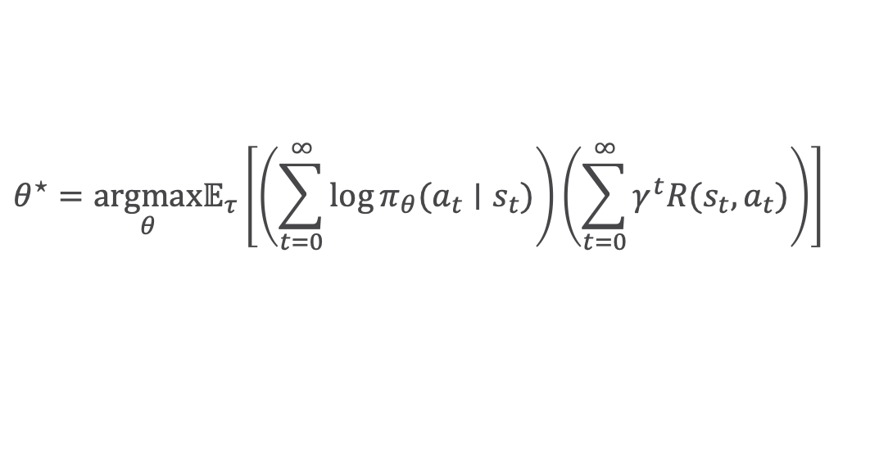
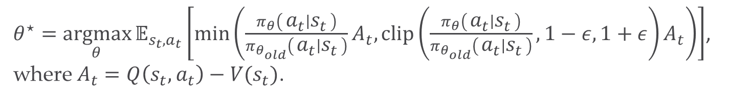
Solution: State of the Arts
Policy Gradient
Proximal Policy Optimization (PPO)
Vanilla Policy Gradient:
$${θ^{⋆}=\underset{θ}{argmax}𝔼}_{τ}\left[\left(\sum_{t=0}^{∞}{\log{π_{θ}(a_{t}∣s_{t})}}\right)\left(\sum_{t=0}^{∞}{γ^{t}R(s_{t},a_{t})}\right)\right]$$
PPO:
$θ^{⋆}=\underset{θ}{argmax}{𝔼_{s_{t},a_{t}}\left[\min\left(\frac{π_{θ}\left(a_{t} ∣ s_{t}\right)}{π_{θ_{old}}\left(a_{t} ∣ s_{t}\right)}A_{t}, clip\left(\frac{π_{θ}\left(a_{t} ∣ s_{t}\right)}{π_{θ_{old}}\left(a_{t} ∣ s_{t}\right)},1−ε,1+ε\right)A_{t}\right)\right]}$, where $A_{t}=Q\left(s_{t}, a_{t}\right)−V(s_{t})$.

Slide 17
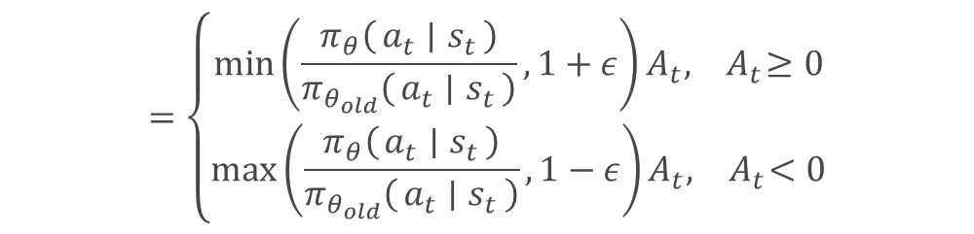
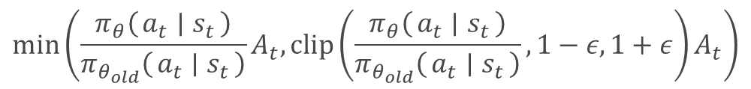
Solution: State of the Arts
Policy Gradient
Proximal Policy Optimization (PPO)
$θ^{⋆}=\underset{θ}{argmax}{𝔼_{s_{t},a_{t}}\left[\min\left(\frac{π_{θ}\left(a_{t} ∣ s_{t}\right)}{π_{θ_{old}}\left(a_{t} ∣ s_{t}\right)}A_{t}, clip\left(\frac{π_{θ}\left(a_{t} ∣ s_{t}\right)}{π_{θ_{old}}\left(a_{t} ∣ s_{t}\right)},1−ε,1+ε\right)A_{t}\right)\right]}$, where $A_{t}=Q\left(s_{t}, a_{t}\right)−V(s_{t})$.
$$\min\left(\frac{π_{θ}\left(a_{t} ∣ s_{t}\right)}{π_{θ_{old}}\left(a_{t} ∣ s_{t}\right)}A_{t}, clip\left(\frac{π_{θ}\left(a_{t} ∣ s_{t}\right)}{π_{θ_{old}}\left(a_{t} ∣ s_{t}\right)},1−ε,1+ε\right)A_{t}\right)$$
$$=\left\{\begin{aligned}\min\left(\frac{π_{θ}\left(a_{t} ∣ s_{t}\right)}{π_{θ_{old}}\left(a_{t} ∣ s_{t}\right)},1+ε\right)A_{t}, { A}_{t}≥0 \\ \max\left(\frac{π_{θ}\left(a_{t} ∣ s_{t}\right)}{π_{θ_{old}}\left(a_{t} ∣ s_{t}\right)},1−ε\right)A_{t}, { A}_{t}<0\end{aligned}\right.$$
Positive advantage, increase probability, no more than $1+ε$
Negative advantage, decrease probability, no less than $1−ε$

Slide 18
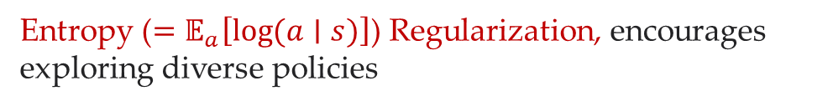
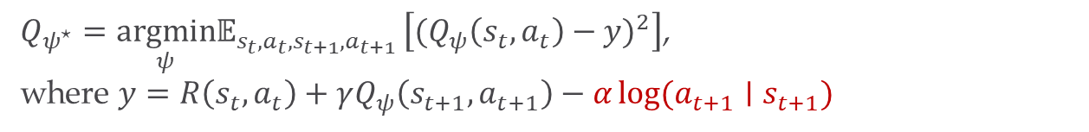
Solution: State of the Arts
Actor-Critic
Soft Actor-Critic (SAC)
$Q_{ψ^{⋆}}=\underset{ψ}{argmin}𝔼_{s_{t},a_{t}, s_{t+1},a_{t+1} }\left[{{(Q}_{ψ}\left(s_{t},a_{t}\right)−y)}^{2}\right]$,
where $y=R\left(s_{t},a_{t}\right)+γQ_{ψ}\left(s_{t+1},a_{t+1}\right)−α\log{(a_{t+1}∣s_{t+1})}$
Critic
Actor
$π_{θ^{⋆}}=\underset{θ}{argmax}𝔼_{s_{t} }\left[Q_{ψ}\left(s_{t},a_{t}\right)−α\log{(a_{t+1}∣s_{t+1})}\right]$, where $a_{t}∼π_{θ}(a_{t}∣s_{t})$
Entropy ($=𝔼_{a}\left[\log{(a∣s)}\right]$) Regularization, encourages exploring diverse policies

Slide 19
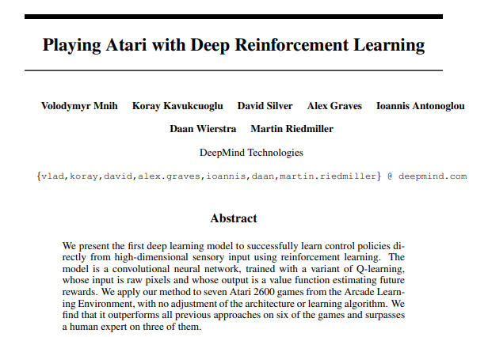
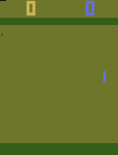



Solution: State of the Arts
Actor-Critic
Modern actor-critic methods also uses an important module termed the Replay Buffer
Agent
State/Observation
Reward
Action
Environment
$$s_{t},a_{t},R(s_{t},a_{t}),s_{t+1}$$
$$Q_{ψ}\left(s_{t},a_{t}\right)$$
Replay Buffer
CNN
MLP
Breaks correlation between samples
Train

Slide 20
Thank you
Haozhe Tian
haozhe.tian21@imperial.ac.uk
haozhetian.com

